Slide 1




Capstone project
Study of Restaurant business in Town of Barnet in England

Slide 2
Evaluation of restaurant locations
In catering services, location is always one of most criteria for successful factor.
Success restaurants are located at places, where
It is closed to target customers
It has no closed substitutes
Access to restaurant from target customers (schools students) should be ease meaning short lead time

Slide 3
Data acquisition and Cleansing
UK school information based on data scrapped from UK authorization
https://www.gov.uk/government/publications/schools-in-england
Postal Code reference for latitude and longitude for UK postal code
https://www.freemaptools.com/download/

Slide 4
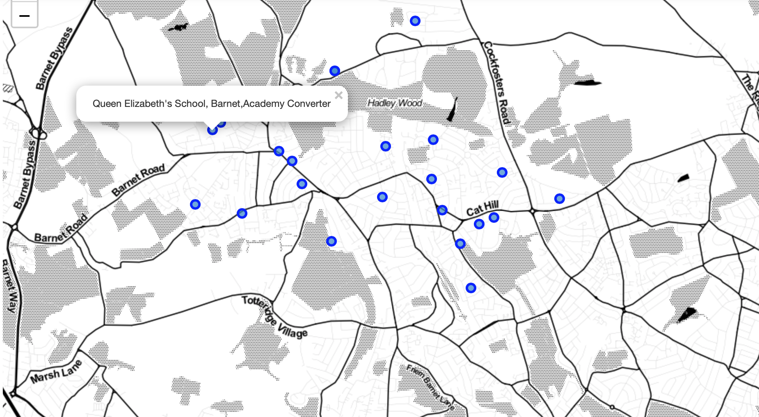
Use Folium to visualize the geo location for schools

Slide 5
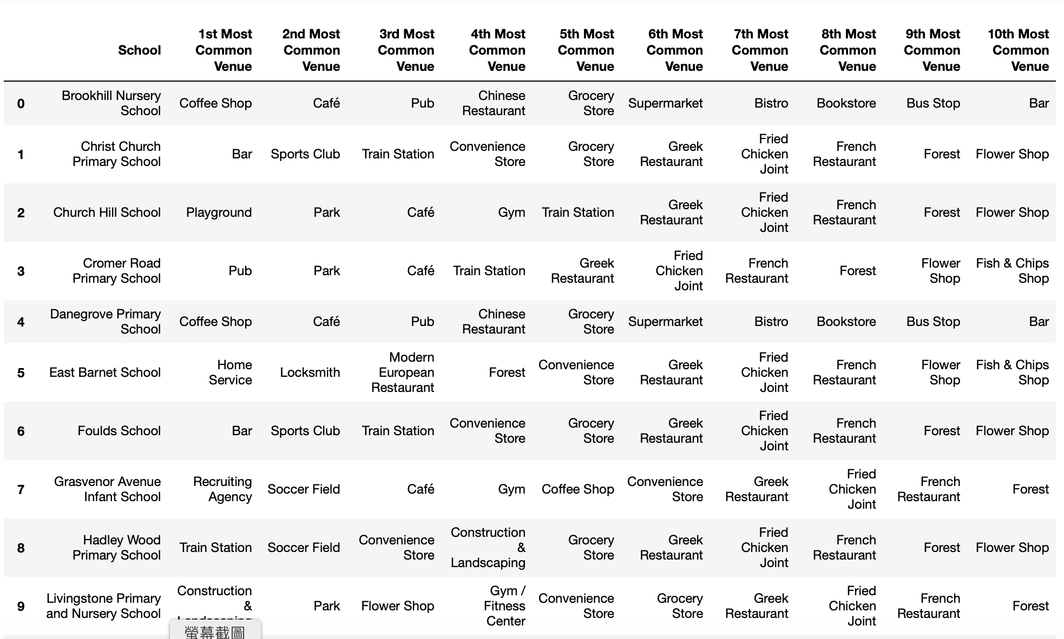
Understand the closed-by venue closed to target schools in Barnet

Slide 6
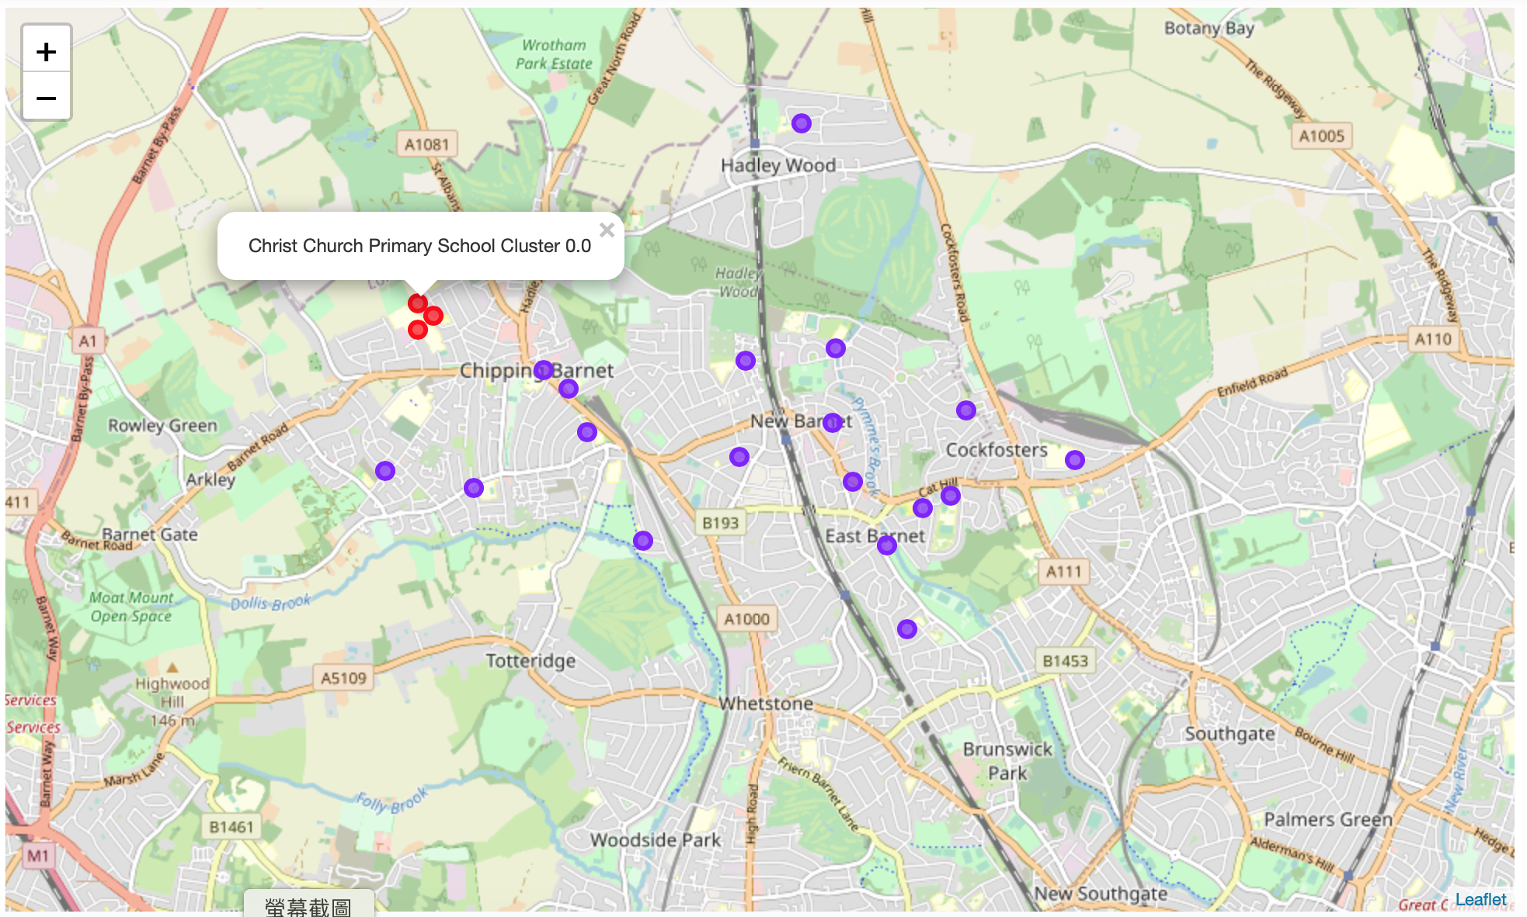
Analysis and Conclusions
Based on above analysis, it can be found that Cluster 0 has much less restaurants and Cluster 1 has much more restaurants. It means if restaurant business is setup at Cluster 1, it can definitely face less competition and most of school students would be served by this restaurant business. Due to proximity of schools, it is more competitive in terms of ease to access the restaurant and transport lead time is limited.
Meanwhile, it is also found that Cluster 1 is more widely spread over the Town of Barnet and it means that it is hard to serve most of schools in the town as there's no centroid that allow ease of access without close substitute / competitions.

